Slide 1
TATA Data Visualization task 3

Slide 2
INTRODUCTION
Hello and welcome.
In this presentation, I will take you through our company's sales performance for the years 2010 and 2011.I appreciate the opportunity you gave me to dive into this data to gain insightful information about the store's performance. Thank you also for the questions you asked since they provided a general direction for the kind of insights you are looking to get from this analysis.

Slide 3
Thought Process
I assure you that I took all the necessary steps to ensure that this analysis is accurateporrectI cleaned up the data you provided by removing all the negative values in the Unit Price and Quantity columns and also filtered the data as required for all the visualizations.

Slide 4
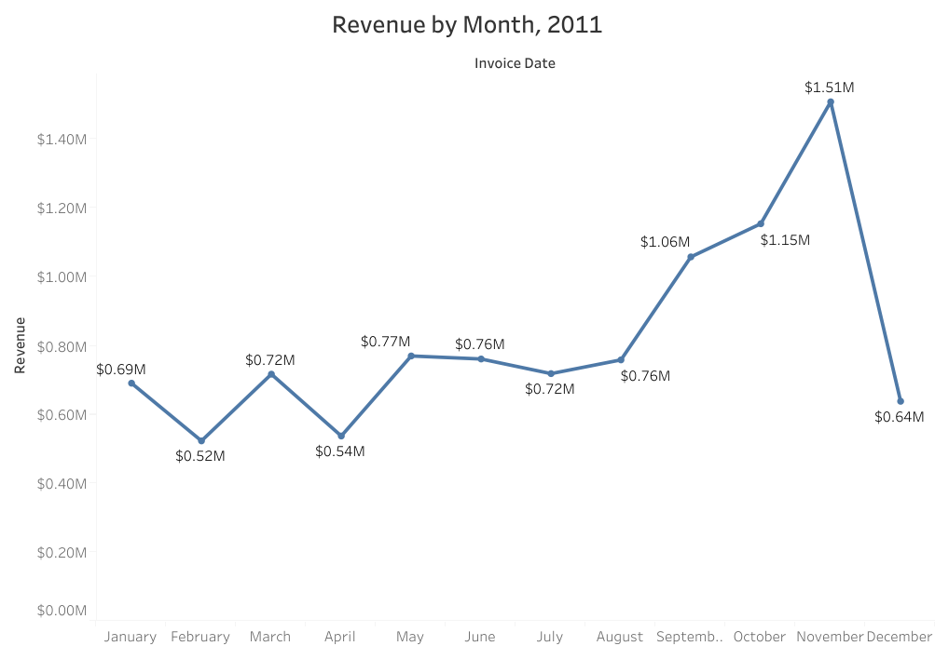

Slide 5
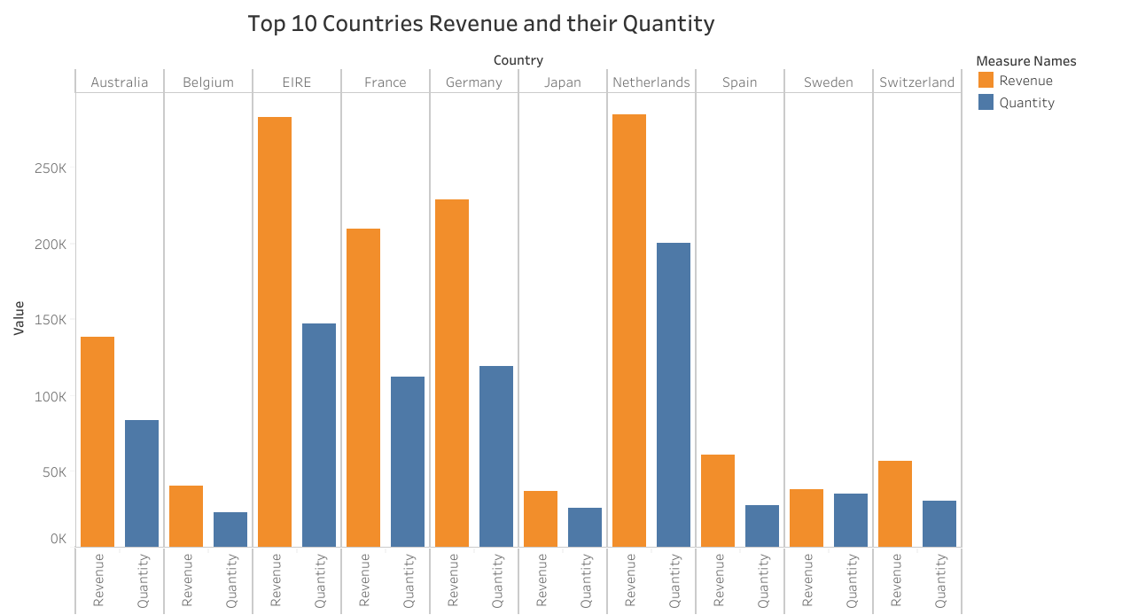

Slide 6
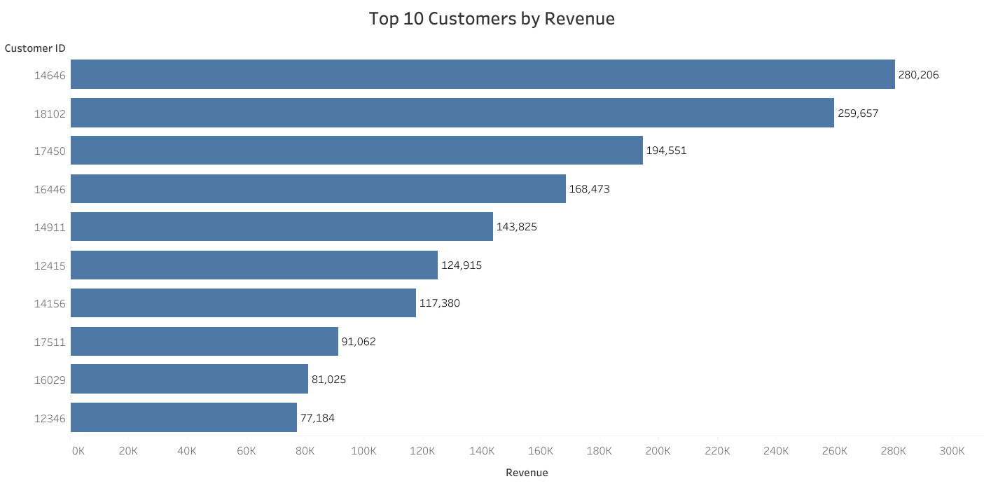

Slide 7
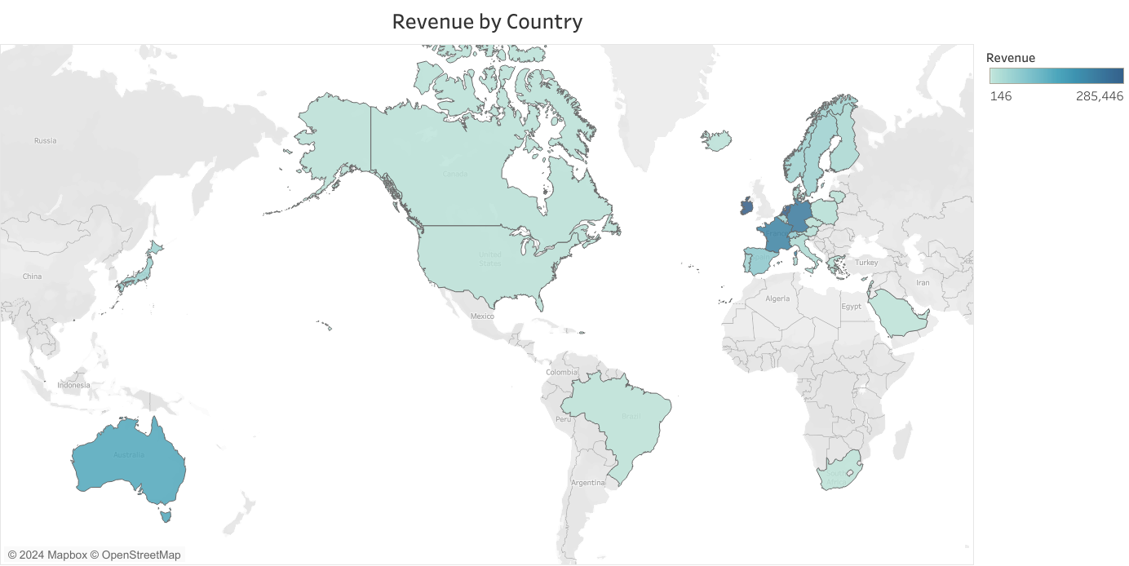

Slide 8
RECOMMENDATIONS
The company should come up with strategies that aim at stocking and advertising seasonal products to maximize sales when the demand for these goods goes up.
The company should do a deeper analysis of products that are usually in high demand during low-sales months to come up with strategies for marketing these products.
A deeper dive into the type of products and the revenue generated from these pro for each region would be key in guiding region- specific marketing strategies.
The company should consider incentivizing top revenue-generating customers to strengthen the relationship with these customers.
The European Market has more potential for growth and the company should aim at strategies that will increase its market positioning in the region

Slide 9


